Slide 1

Chandigarh University
Department of Mathematics
B.Tech. CSE (Core/DS/IT/CC)
Semester-3
Subject Code:25MTT-202
Discrete Mathematics
Unit - 5 (Chapter- 5.2.1)
Dr. SARTAJ
DISCOVER . LEARN . EMPOWER

Slide 2

CO mappings

Slide 3

CO-PO mappings
Note: Degree of relevance/correlation: 1-Low, 2-Medium, 3-High, Blank or ‘- ‘- Nil

Slide 4
Topics Overview
Sub-Graph, Spanning graph, Connected graph
Conclusions
Video links
References

Slide 5
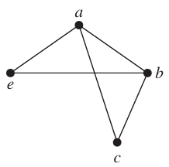
Subgraph and Spanning Graph
Subgraph: When edges and vertices are removed from a graph, without removing endpoints of any remaining edges, a smaller graph is obtained. Such a graph is called a subgraph of the original graph.
or
A graph H = (V', E') is called subgraph of G = (V, E) if V' is subset of V and E' is subset of E.
Example:
is the subgraph of K₅
ns

Slide 6
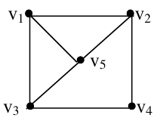
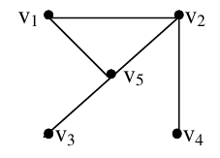
Subgraph and Spanning Graph
Spanning Subgraph: H is a spanning subgraph of graph G if it contains all the vertices of G, i.e., V' = V.
Example:
is the spanning subgraph of
ns

Slide 7

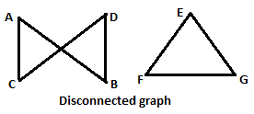
Connected Graph
Connected graph: It is a graph where must be a path between every pair of vertices.
Disconnected graph: It is a graph where exist a pair of vertices such that there is no path between them.
Note: A disconnected graph is a union of two or more disjoint connected subgraphs. These disjoint connected subgraphs are called the component of the disconnected graph.
ns

Slide 8
Activity-1
Write all the possible spanning subgraphs of
4-Regular Graph
K₄
K₅

Slide 9
Conclusion
Subgraph and spanning graphs are discussed.
Related examples are given.
ns

Slide 10
Video Links
https://youtu.be/j3lrgY_sH44?si=RHcyCOoz3itig_RY
(Video Links)
https://drive.google.com/file/d/1zm_o2dthNGIi-OXsgP8McUz4SUlb9q3p/view?usp=sharing
(Book Link)

Slide 11
References
Sr. No. | Author | Name of the Book | Publisher | Year of Publication
1 | Kenneth H. Rosen | Discrete Mathematics and Its Applications | McGraw-Hill | 2019
2 | C. L. Liu | Elements of Discrete Mathematics | McGraw-Hill | 1996
3 | J. P. Tremblay, R. Manohar | Discrete Mathematical Structures with Applications to Computer Science | Tata McGraw Hill | 2001
4 | Kolman, Busby, Ross | Discrete Mathematical Structures | PHI | 2001
5 | Narsingh Deo | Graph Theory with Applications to Engineering and | PHI | 2017

Slide 12
Thanks!!!

